Slide 1


Is delay always
harmful to precision?
Nikolett Német*, Scott Parkins
University of Auckland,
The Dodd-Walls Centre for Photonic and Quantum Technologies
Physics Seminar 01/06/16
*n.nemet@auckland.ac.nz

Slide 2
Measurement precision
Examples of precision measurements (Classical, quantum counterpart!!!)
Thermometer
Magnetometer
Interferometer (gravitational waves)
Classically
Origins of uncertainty: temperature, background radiations, gravitational field, trembling of earth, (other unexpected: bicycle, elevator, bird ☺), etc.
Quantum mechanically:
Heisenberg’s uncertainty, Standard Quantum Limit
Minimum uncertainty states:
Coherent state: same uncertainty in e.g. position and momentum
Squeezed state: reduced uncertainty in e.g. position, increased in momentum

Slide 3
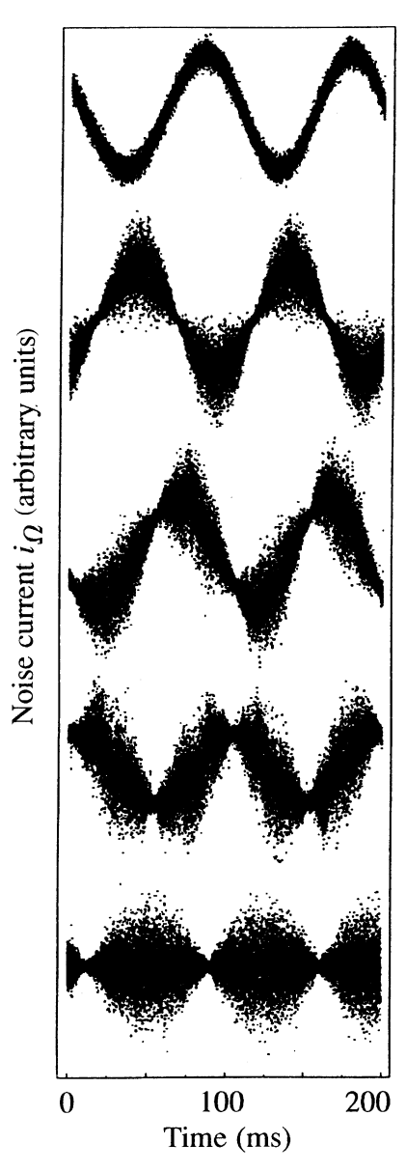
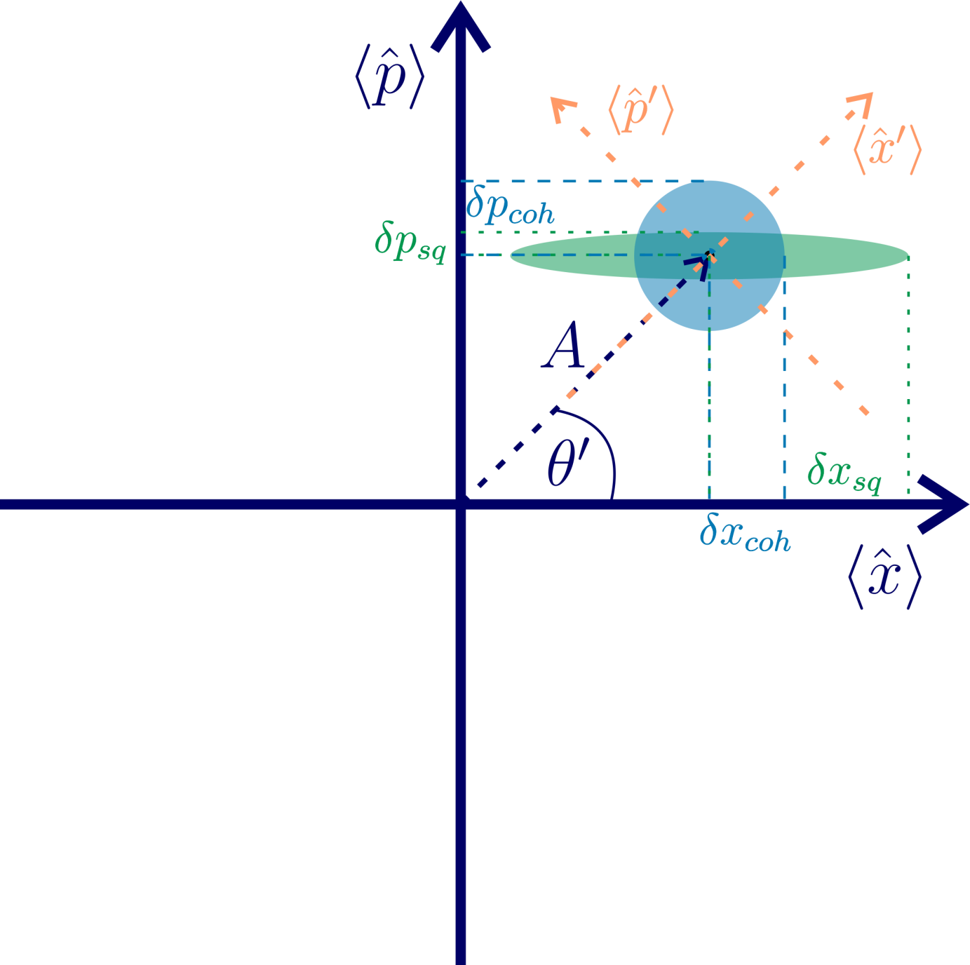
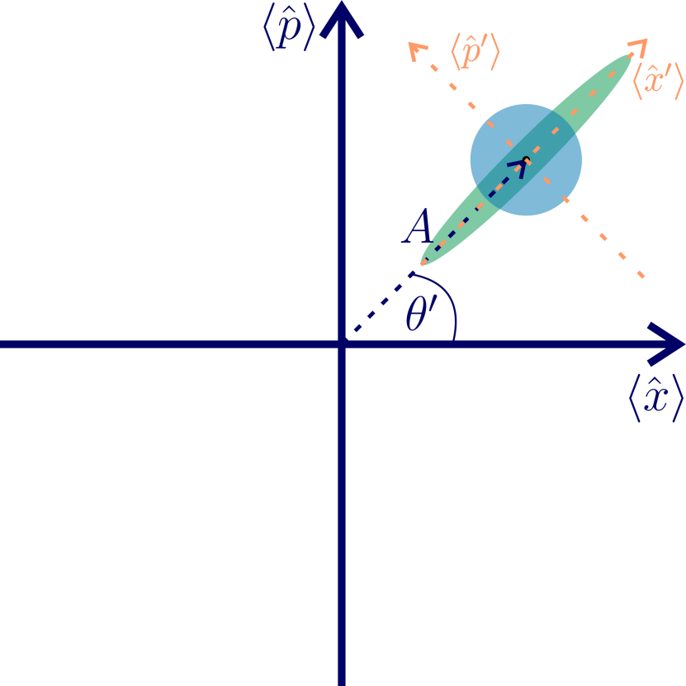
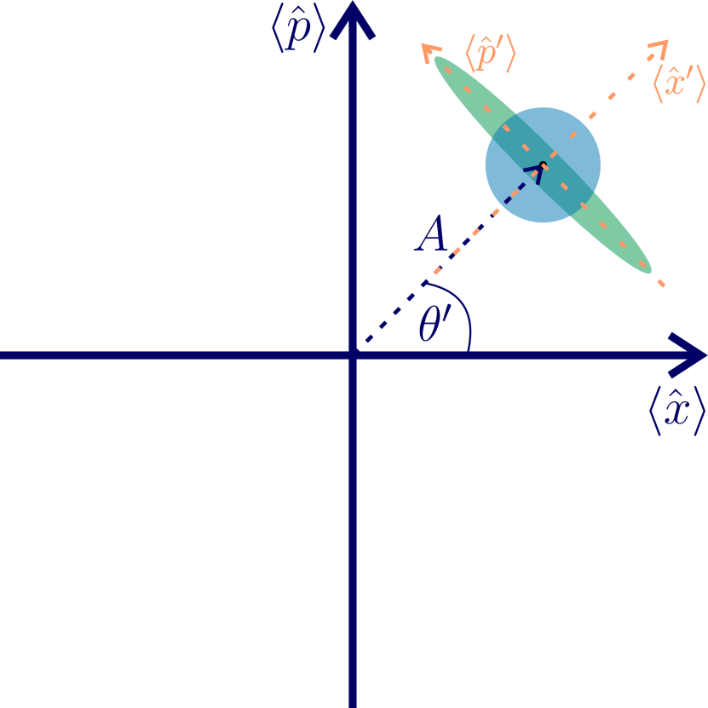
Squeezed State
Harmonic oscillator can be described by
Position and momentum: trajectory depicts a circle
Amplitude and phase
Phase squeezed state
Amplitude squeezed state

Slide 4
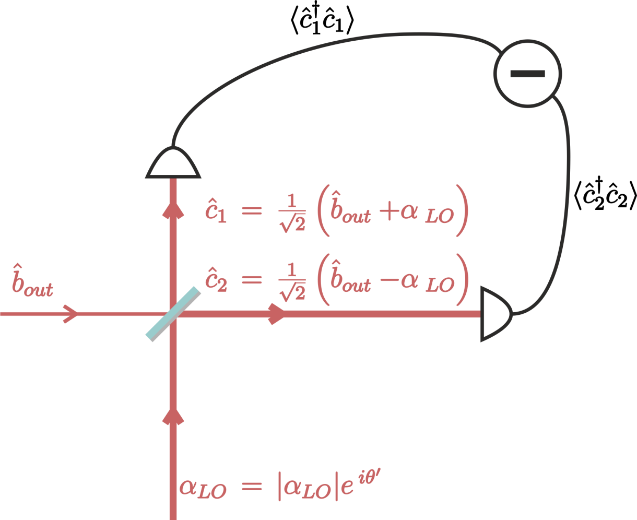
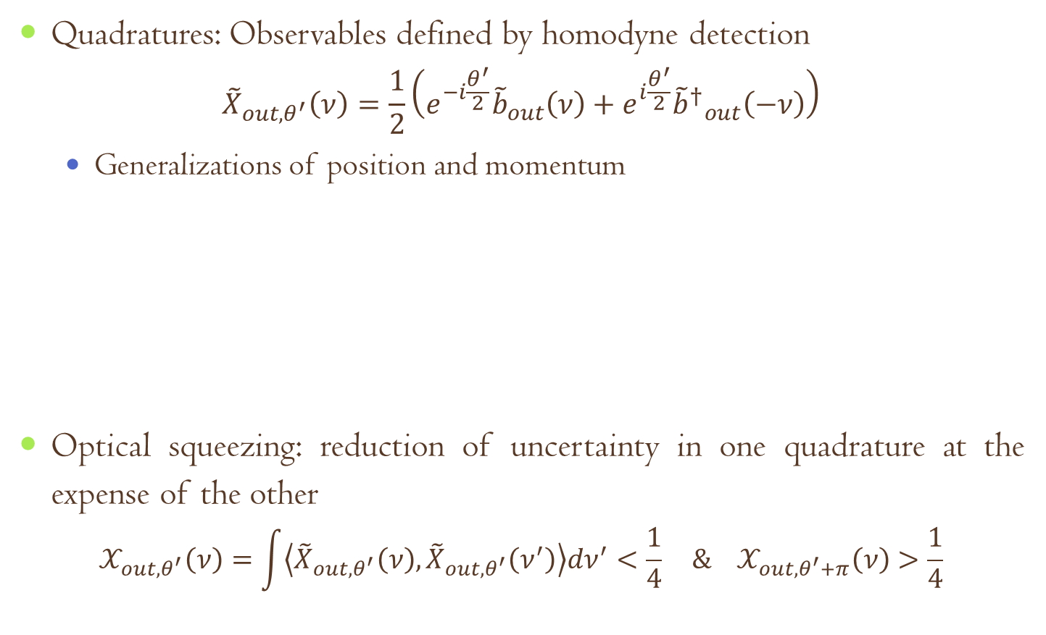
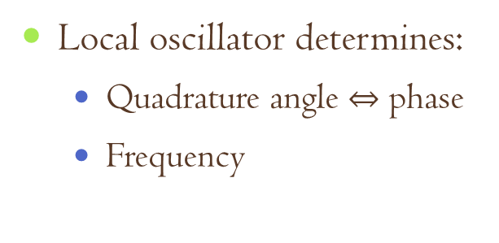
Optical squeezing
Quadratures: Observables defined by homodyne detection
$${\tilde{X}}_{out,θ^{′}}\left(ν\right)=\frac{1}{2}\left(e^{−i\frac{θ^{′}}{2}}{\tilde{b}}_{out}\left(ν\right)+e^{i\frac{θ^{′}}{2}}{{\tilde{b}}^{†}}_{out}^{}\left(−ν\right)\right)$$
Generalizations of position and momentum
Optical squeezing: reduction of uncertainty in one quadrature at the expense of the other
$$𝒳_{out,θ^{′}}\left(ν\right)=\int{\left\langle {\tilde{X}}_{out,θ^{′}}\left(ν\right),{\tilde{X}}_{out,θ^{′}}\left(ν^{′}\right)\right\rangle dν^{′}<\frac{1}{4}} \& 𝒳_{out,θ^{′}+π}\left(ν\right)>\frac{1}{4}$$
Local oscillator determines:
Quadrature angle $⇔$ phase
Frequency

Slide 5
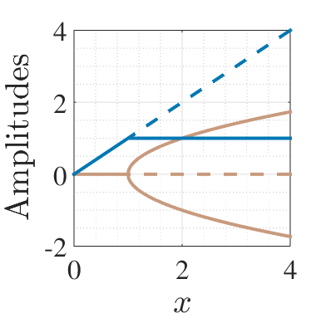
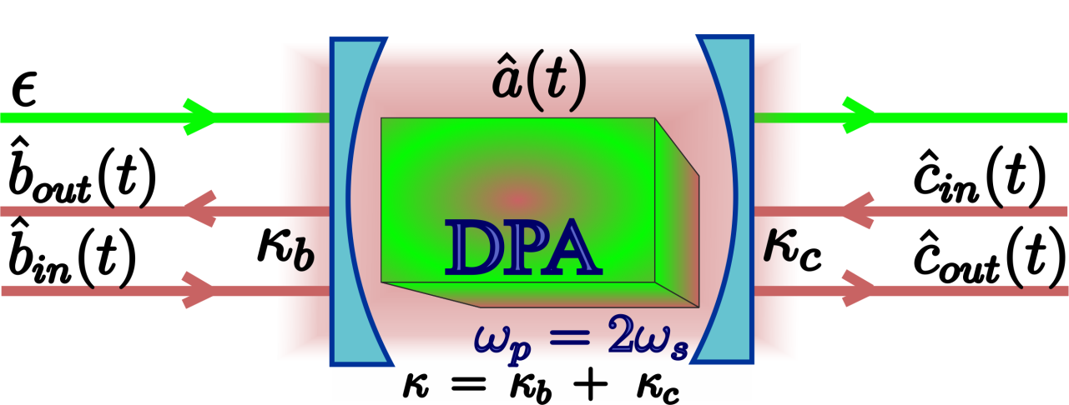
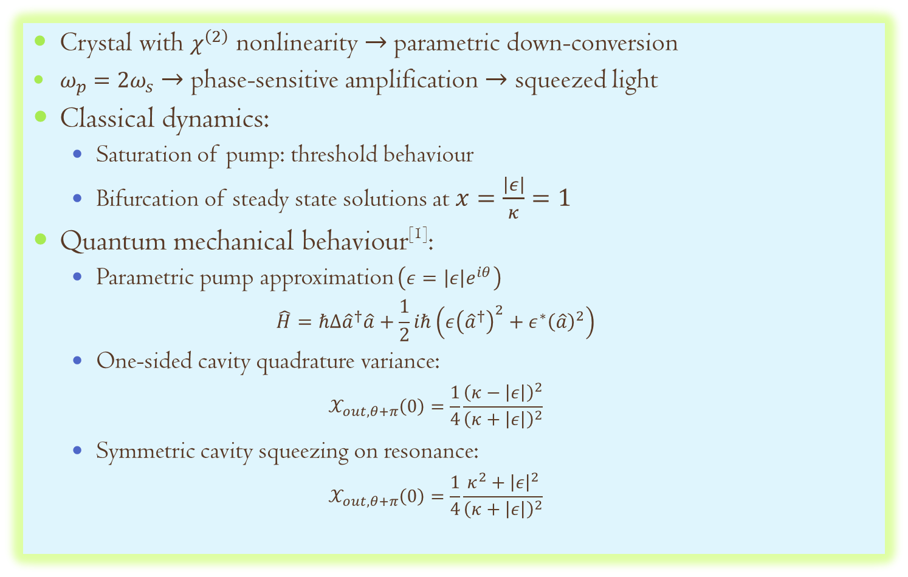
Degenerate Parametric Amplifier
Crystal with $χ^{\left(2\right)}$ nonlinearity $→$parametric down-conversion
$ω_{p}=2ω_{s}$ $→$ phase-sensitive amplification $→$ squeezed light
Classical dynamics:
Saturation of pump: threshold behaviour
Bifurcation of steady state solutions at $x=\frac{\left|ε\right|}{κ}=1$
Quantum mechanical behaviour^{[1]}:
Parametric pump approximation $\left(ε=\left|ε\right|e^{iθ}\right)$
$$\hat{H}=ℏΔ{\hat{a}}^{†}\hat{a}+\frac{1}{2}iℏ\left(ε{\left({\hat{a}}^{†}\right)}^{2}+ε^{∗}{\left(\hat{a}\right)}^{2}\right)$$
One-sided cavity quadrature variance:
$$𝒳_{out,θ+π}\left(0\right)=\frac{1}{4}\frac{{\left(κ−\left|ε\right|\right)}^{2}}{{\left(κ+\left|ε\right|\right)}^{2}}$$
Symmetric cavity squeezing on resonance:
$$𝒳_{out,θ+π}\left(0\right)=\frac{1}{4}\frac{κ^{2}+{\left|ε\right|}^{2}}{{\left(κ+\left|ε\right|\right)}^{2}}$$

Slide 6
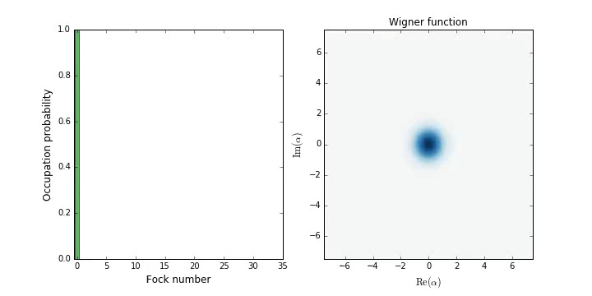
Degenerate Parametric Amplifier
Output below threshold: squeezed vacuum
Note: squeezed vacuum has finite number of photons in it

Slide 7
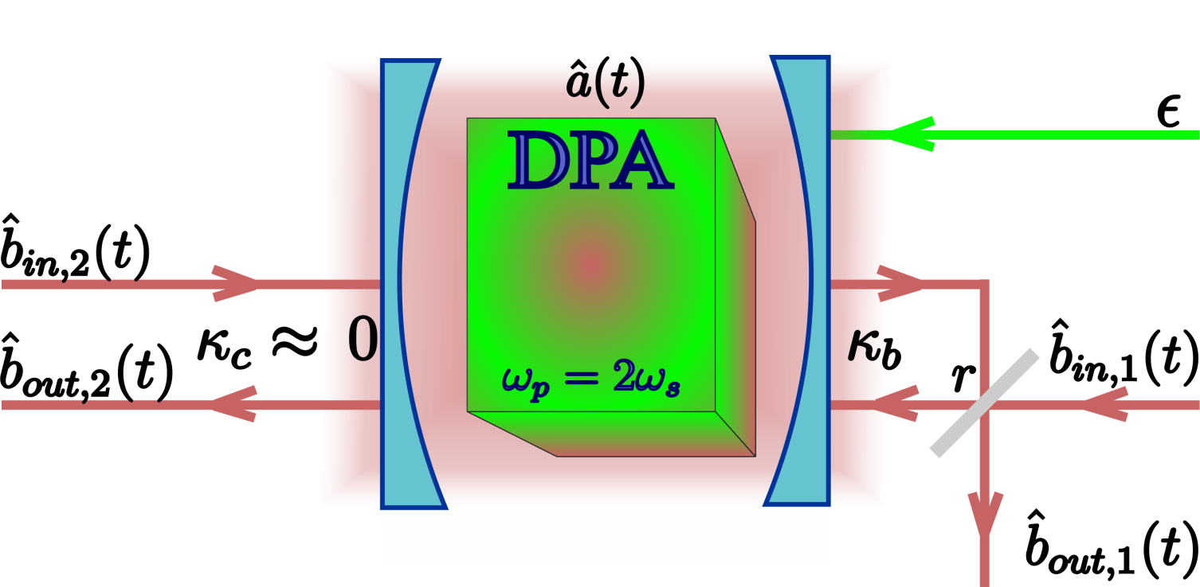
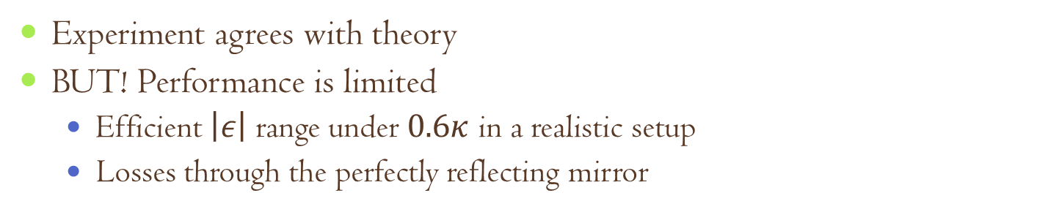
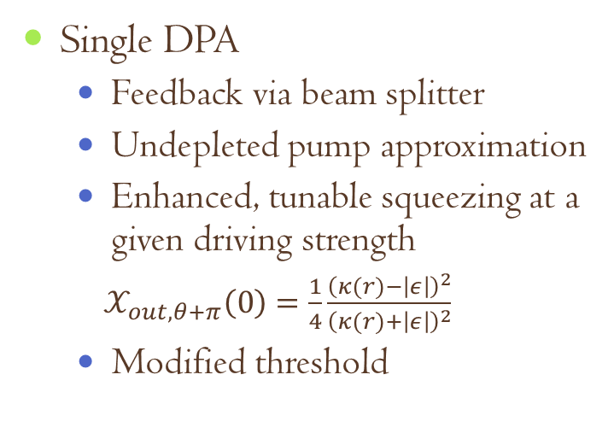
Coherent feedback with DPA
Coherent feedback: Quantum feedback without measurement
Single DPA
Feedback via beam splitter
Undepleted pump approximation
Enhanced, tunable squeezing at a given driving strength
$𝒳_{out,θ+π}\left(0\right)=\frac{1}{4}\frac{{\left(κ(r)−\left|ε\right|\right)}^{2}}{{\left(κ(r)+\left|ε\right|\right)}^{2}}$
Modified threshold
Experiment agrees with theory
BUT! Performance is limited
Efficient $\left|ε\right|$ range under $0.6κ$ in a realistic setup
Losses through the perfectly reflecting mirror
^{[1]} J. E. Gough, S. Wildfeuer, PRA, 80:042107 (2009), ^{[2]}A. Furusawa’s group, IEEE Trans. Auto. Contr., 57:2045 (2012)

Slide 8
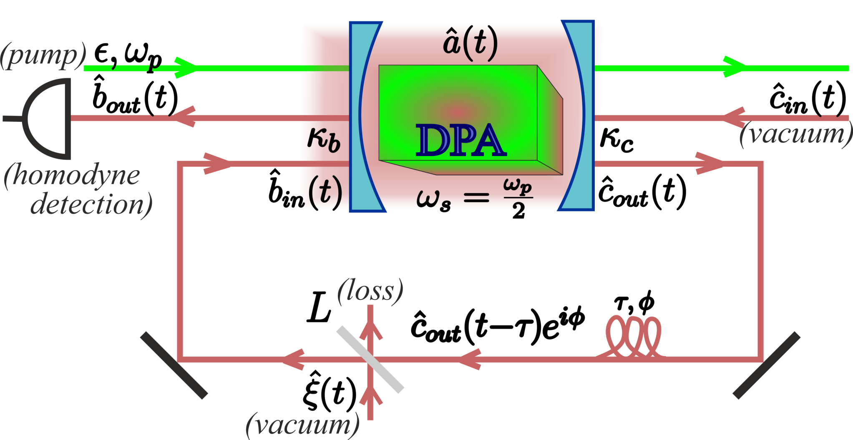
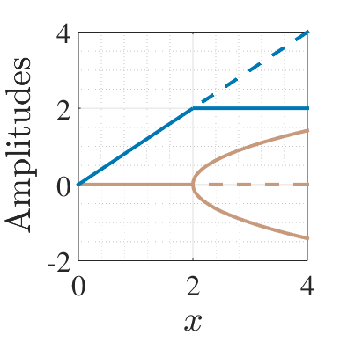
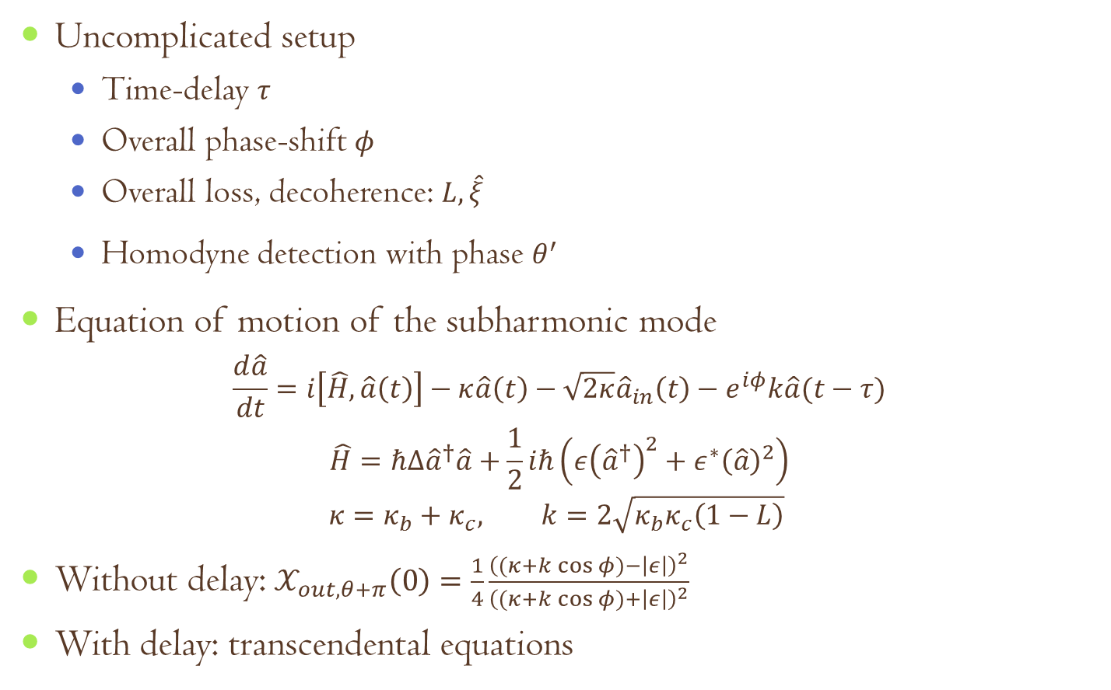
DPA with time-delayed coherent feedback
Uncomplicated setup
Time-delay $τ$
Overall phase-shift $φ$
Overall loss, decoherence: $L,\hat{ξ}$
Homodyne detection with phase $θ^{′}$
Equation of motion of the subharmonic mode
$$\frac{d\hat{a}}{dt}=i\left[\hat{H},\hat{a}\left(t\right)\right]−κ\hat{a}\left(t\right)−\sqrt{2κ}{\hat{a}}_{in}\left(t\right)−e^{iφ}k\hat{a}(t−τ)$$
$$\hat{H}=ℏΔ{\hat{a}}^{†}\hat{a}+\frac{1}{2}iℏ\left(ε{\left({\hat{a}}^{†}\right)}^{2}+ε^{∗}{\left(\hat{a}\right)}^{2}\right)$$
$$κ=κ_{b}+κ_{c}, k=2\sqrt{κ_{b}κ_{c}\left(1−L\right)}$$
Without delay: $𝒳_{out,θ+π}\left(0\right)=\frac{1}{4}\frac{{\left((κ+k\cos{φ})−\left|ε\right|\right)}^{2}}{{\left((κ+k\cos{φ})+\left|ε\right|\right)}^{2}}$
With delay: transcendental equations

Slide 9
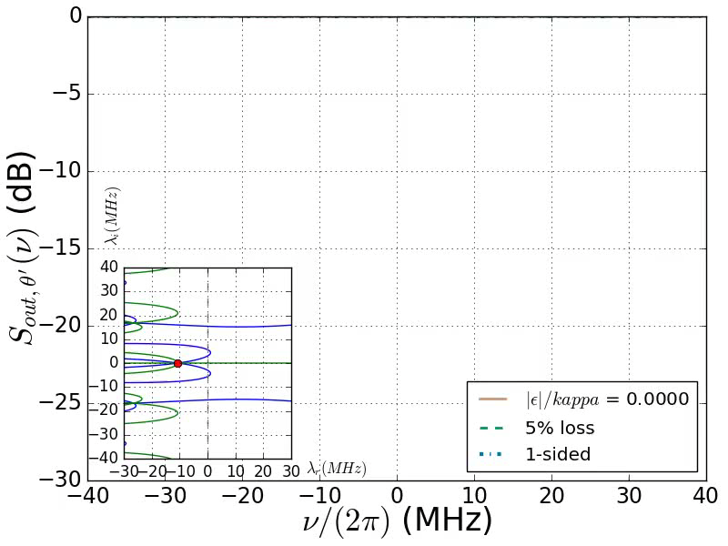

Squeezing spectra for $φ=π$

Slide 10
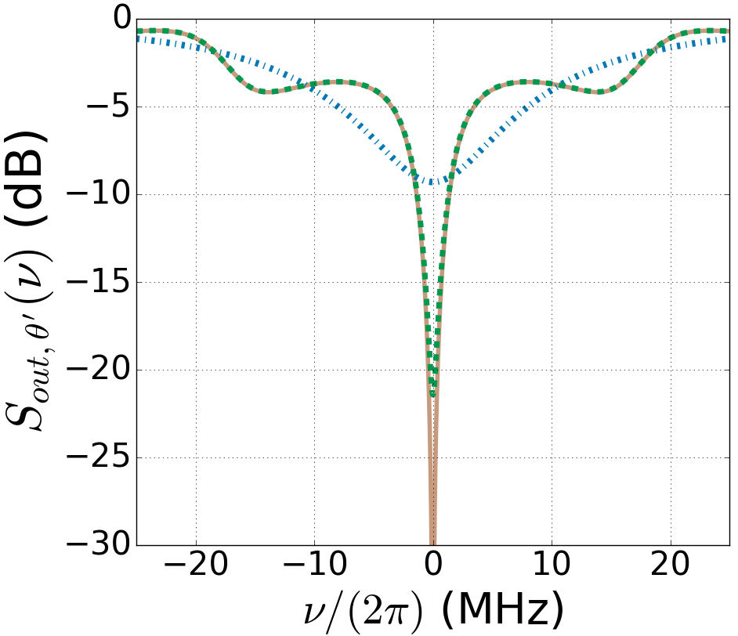
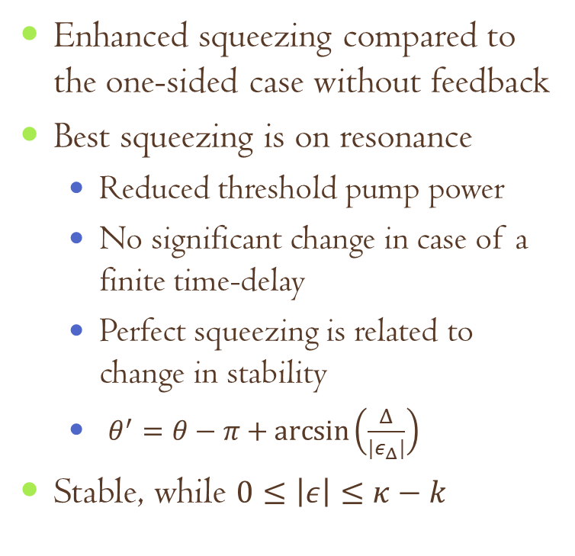
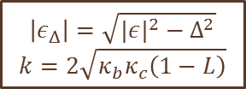

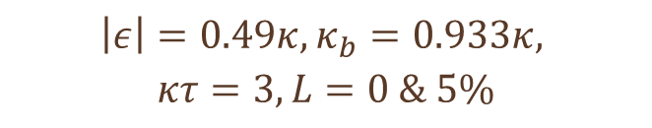
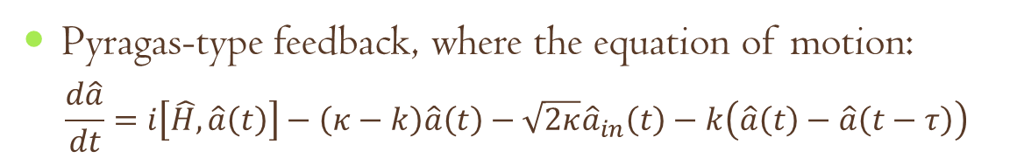
Squeezing for $φ=π$
Enhanced squeezing compared to the one-sided case without feedback
Best squeezing is on resonance
Reduced threshold pump power
No significant change in case of a finite time-delay
Perfect squeezing is related to change in stability
$θ^{′}=θ−π+\arcsin\left(\frac{Δ}{{|ε}_{Δ}|}\right)$
Stable, while $0≤\left|ε\right|≤κ−k$
$$\left|ε\right|=0.49κ, κ_{b}=0.933κ,$$
$$κτ=3,L=0 \& 5\%$$
Pyragas-type feedback, where the equation of motion:
$$\frac{d\hat{a}}{dt}=i\left[\hat{H},\hat{a}\left(t\right)\right]−\left(κ−k\right)\hat{a}\left(t\right)−\sqrt{2κ}{\hat{a}}_{in}\left(t\right)−k\left(\hat{a}\left(t\right)−\hat{a}\left(t−τ\right)\right)$$
$$\left|ε_{Δ}\right|=\sqrt{|{ε|}^{2}−Δ^{2}}$$
$$k=2\sqrt{κ_{b}κ_{c}\left(1−L\right)}$$

Slide 11
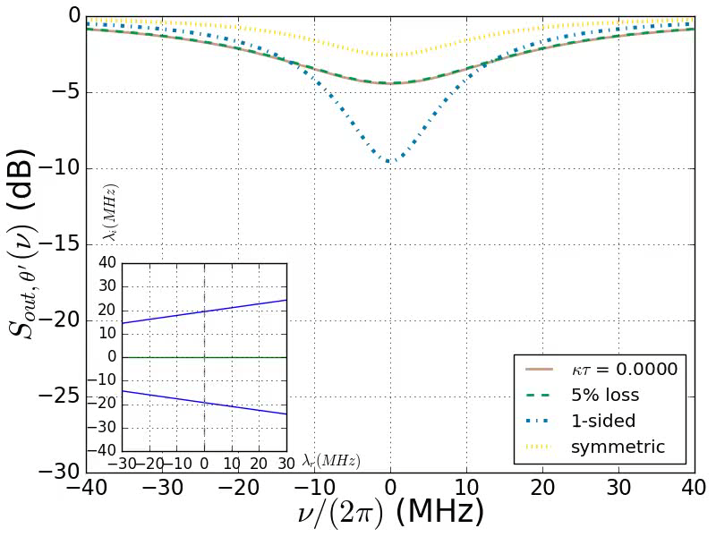

Squeezing spectra for $φ=0$

Slide 12
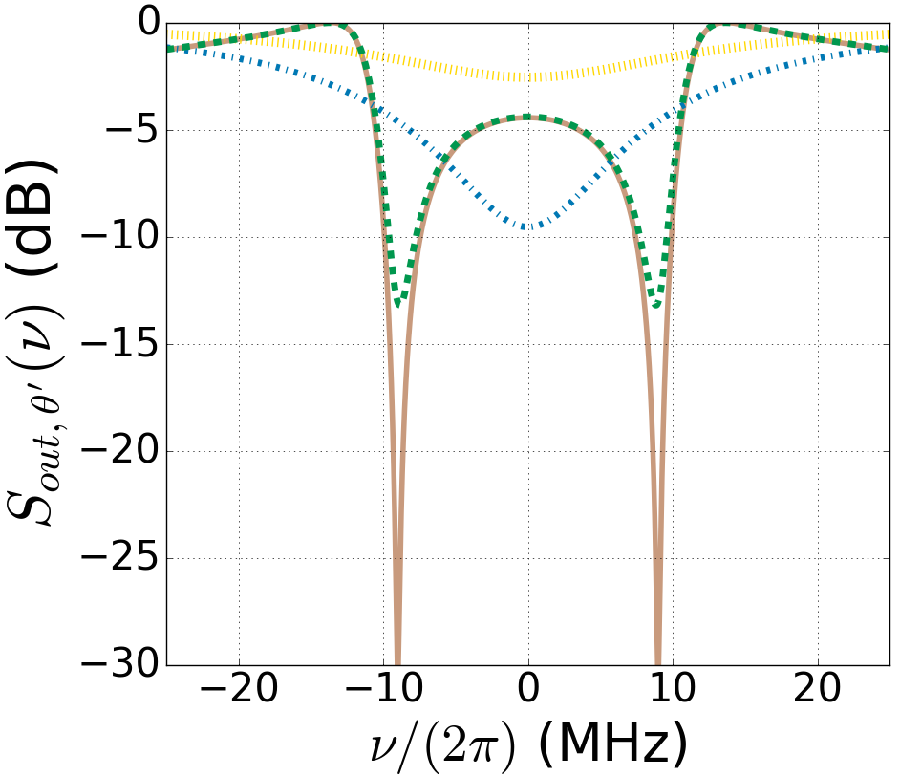
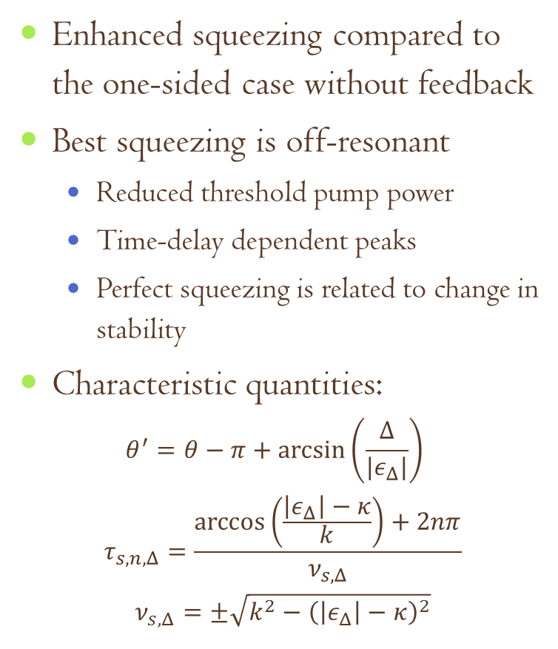

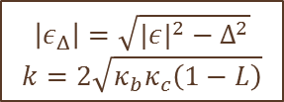
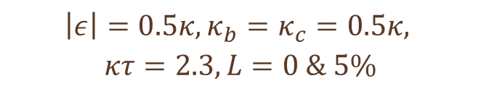
Squeezing for $φ=0$
Enhanced squeezing compared to the one-sided case without feedback
Best squeezing is off-resonant
Reduced threshold pump power
Time-delay dependent peaks
Perfect squeezing is related to change in stability
Characteristic quantities:
$$θ^{′}=θ−π+\arcsin\left(\frac{Δ}{{|ε}_{Δ}|}\right)$$
$$τ_{s,n,Δ}=\frac{\arccos\left(\frac{\left|ε_{Δ}\right|−κ}{k}\right)+2nπ}{ν_{s,Δ}}$$
$$ν_{s,Δ}=±\sqrt{k^{2}−{\left(\left|ε_{Δ}\right|−κ\right)}^{2}}$$
$$\left|ε\right|=0.5κ, κ_{b}=κ_{c}=0.5κ,$$
$$κτ=2.3,L=0 \& 5\%$$
$$\left|ε_{Δ}\right|=\sqrt{|{ε|}^{2}−Δ^{2}}$$
$$k=2\sqrt{κ_{b}κ_{c}\left(1−L\right)}$$

Slide 13
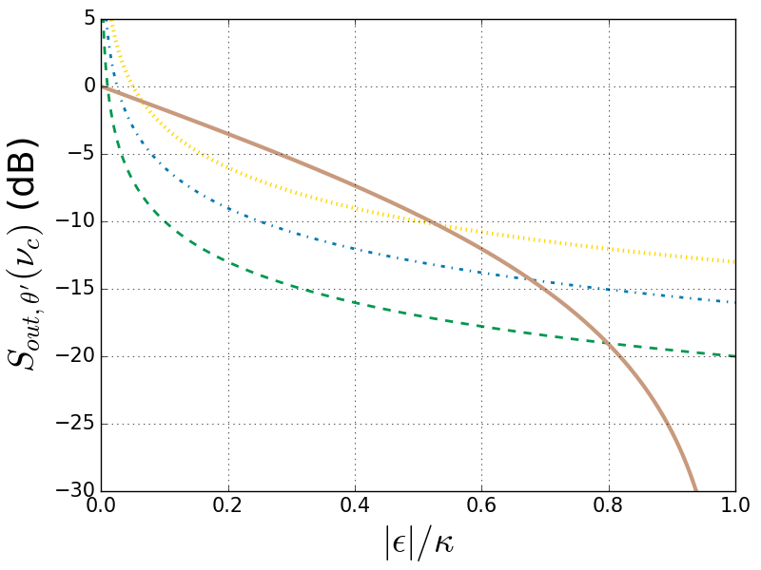
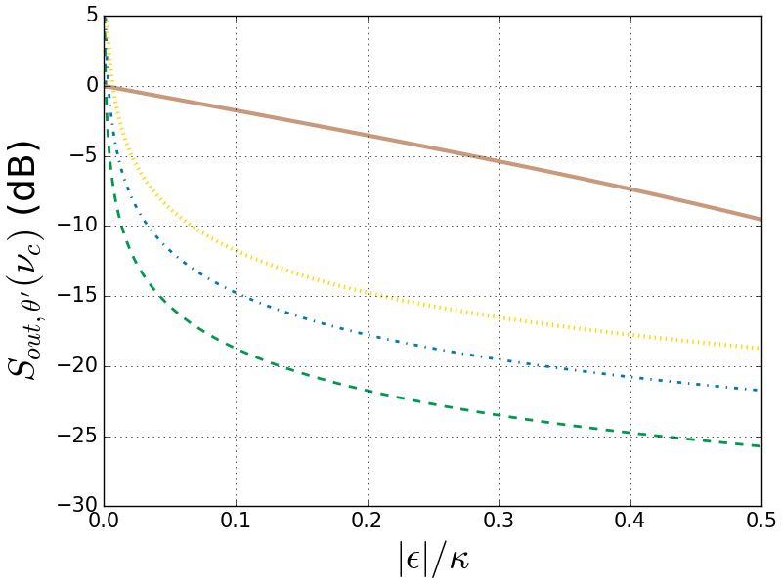
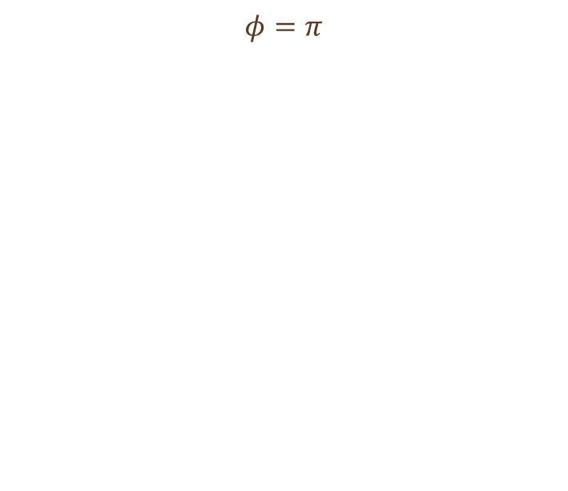
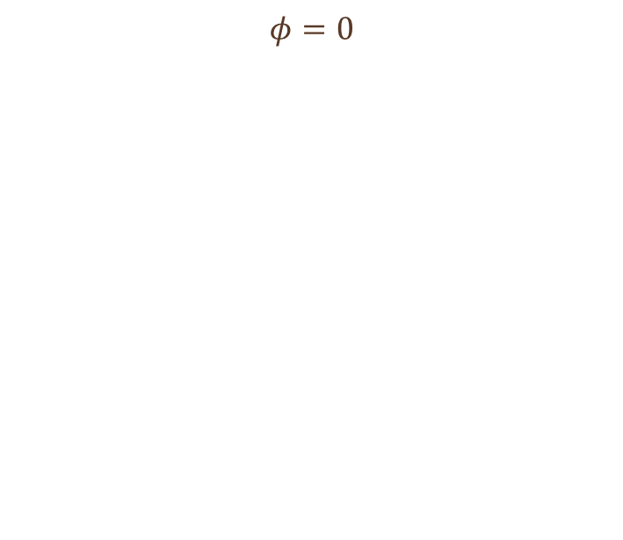
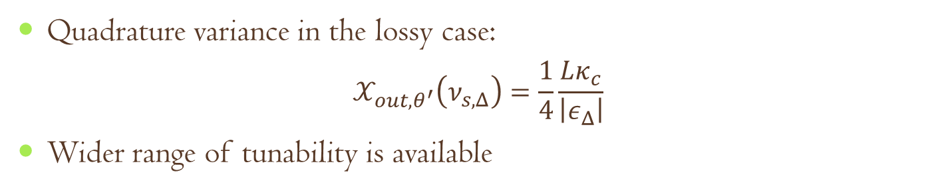
Effect of loss in the feedback loop
Quadrature variance in the lossy case:
$$𝒳_{out,θ^{′}}\left(ν_{s,Δ}\right)=\frac{1}{4}\frac{Lκ_{c}}{\left|ε_{Δ}\right|}$$
Wider range of tunability is available
$$φ=0$$
$$φ=π$$

Slide 14
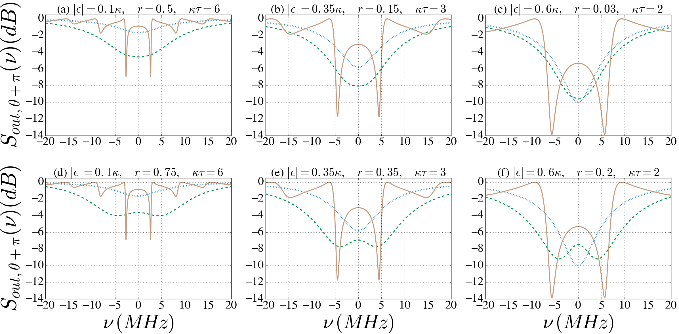
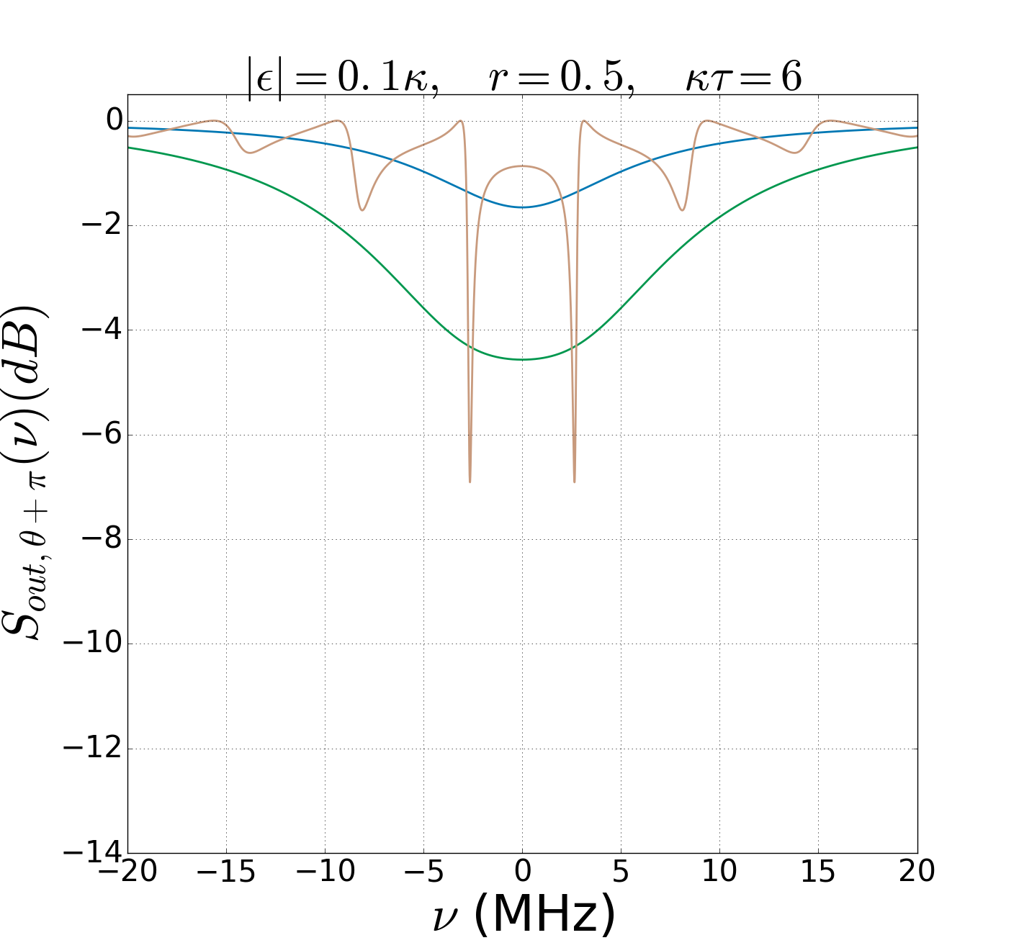
Comparison with previous results
with BS
feedback
without
feedback
with delayed feedback
without
feedback
with BS
feedback
without
feedback
with BS
feedback
with delayed feedback
with delayed feedback

Slide 15
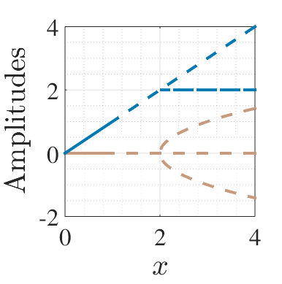
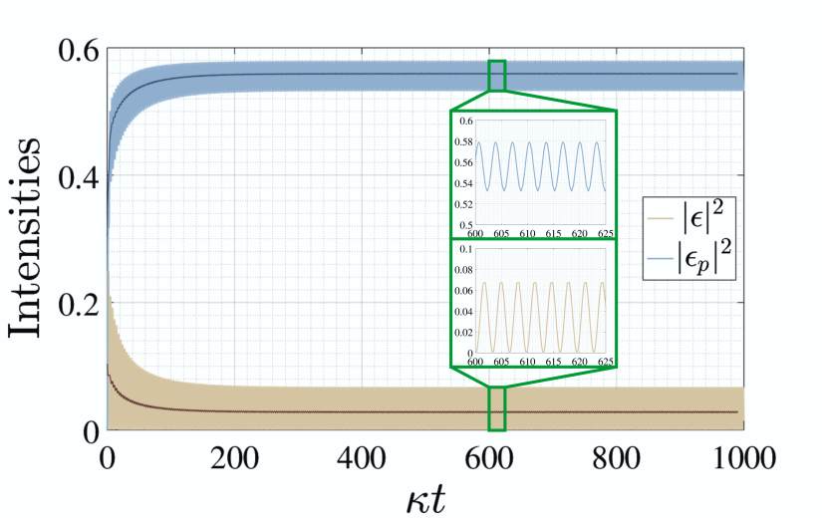
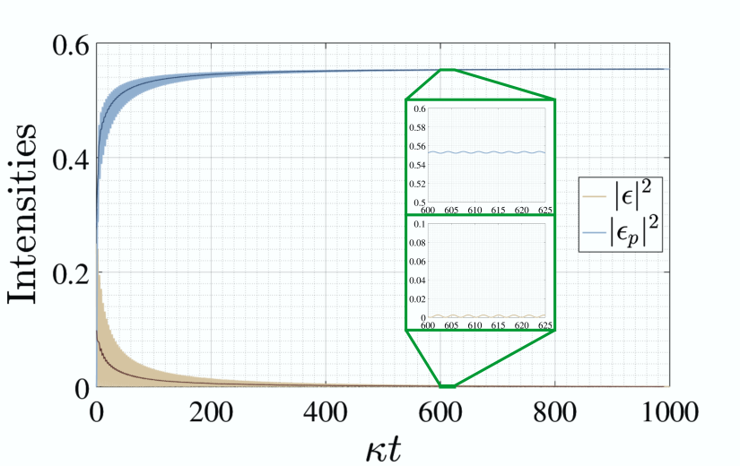
Classical analysis
Threshold: changing stability
Pitchfork bifurcation: different steady states
Tuned by pump strength
Hopf bifurcation: reaching a limit cycle
Tuned by time delay and pump strength
Imaginary eigenvalue becomes the frequency of persistent oscillations

Slide 16
Summary
Enhanced precision in measurements with the help of squeezed states of light
Coherent feedback: backaction-free way of improving the signal to noise ratio
Time-delay: tunable changes in the stability landscape
In a time-delayed one-loop setup with a DPA, dramatically enhanced squeezing was found
Enhancement even compared to previous feedback setups
Result of the changing dynamics of the system
Loss in the feedback loop decreases the degree of squeezing, but also provides higher tunability

Slide 17
Thank you for your
attention!

Slide 18
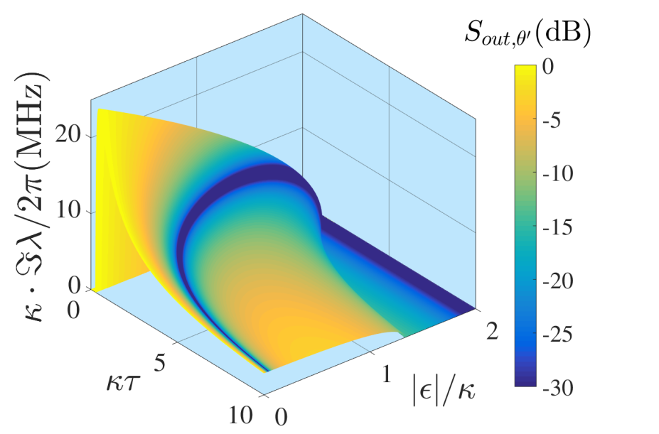
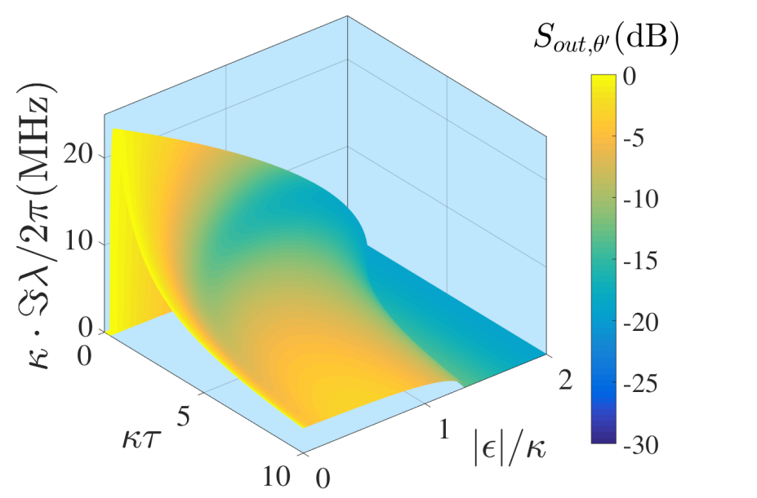
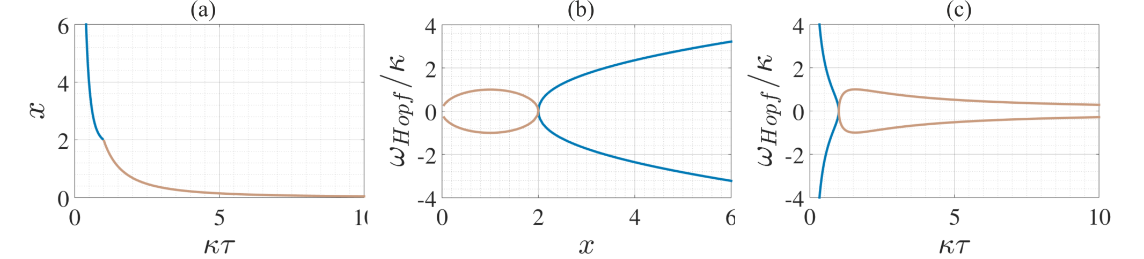
Tunability
$$0≤ν_{s}≤\sqrt{\left|ε\right|\left(2κ−\left|ε\right|\right)},0≤\left|ε\right|≤\left|κ+ke^{iφ}\right|$$

Slide 19
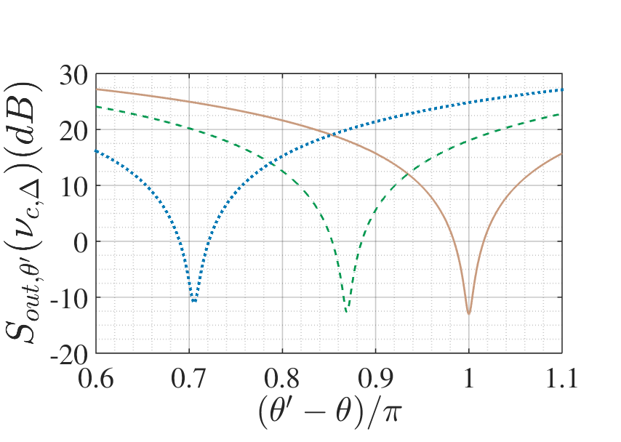
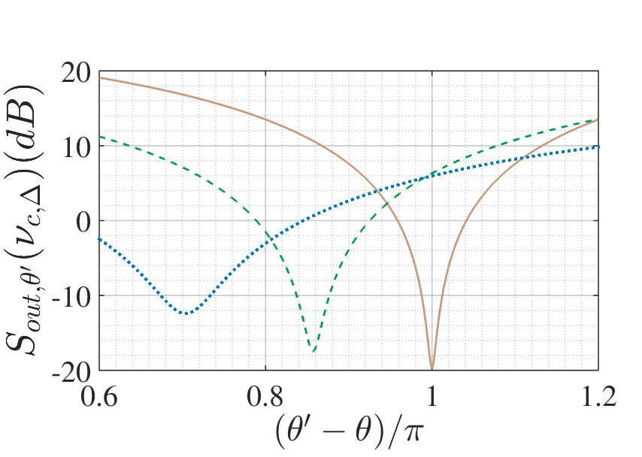
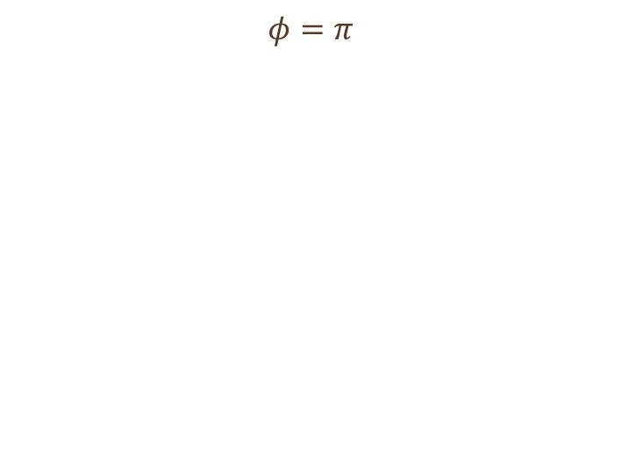
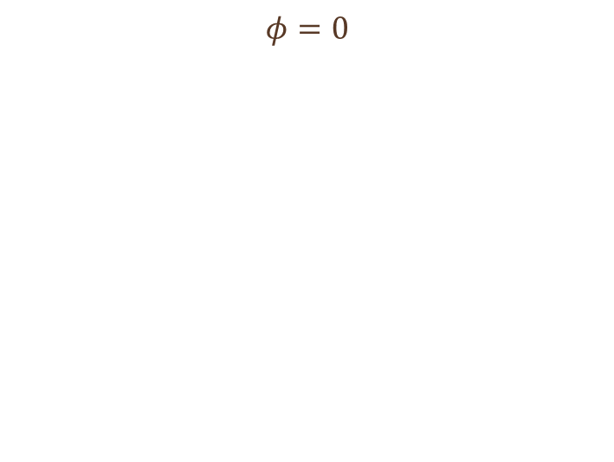

Effects of detuning
$$θ^{′}=θ−π+\arcsin\left(\frac{Δ}{{|ε}_{Δ}|}\right)$$
$$τ_{s,n,Δ}=\frac{\arccos\left(\frac{\left|ε_{Δ}\right|−κ}{k}\right)+2nπ}{ν_{s,Δ}}$$
$$ν_{s,Δ}=±\sqrt{k^{2}−{\left(\left|ε_{Δ}\right|−κ\right)}^{2}}$$
$$φ=0$$
$$φ=π$$

Slide 20
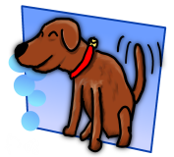

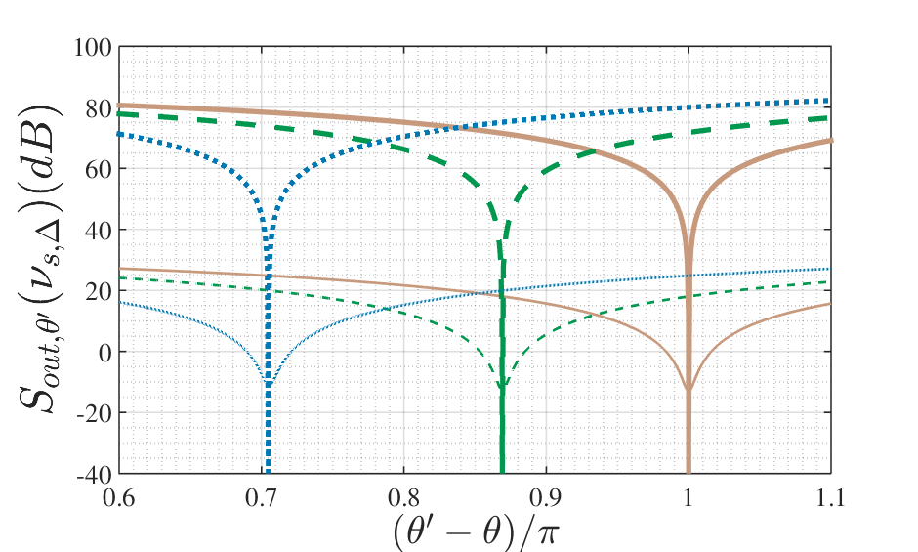
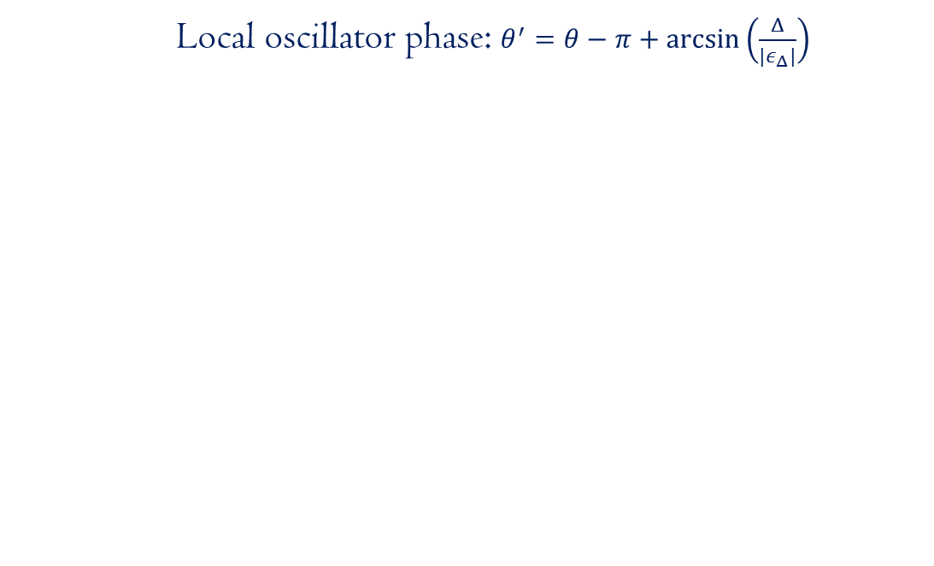
Detuning and quadrature angle
Local oscillator phase: $θ^{′}=θ−π+\arcsin\left(\frac{Δ}{{|ε}_{Δ}|}\right)$

Slide 21
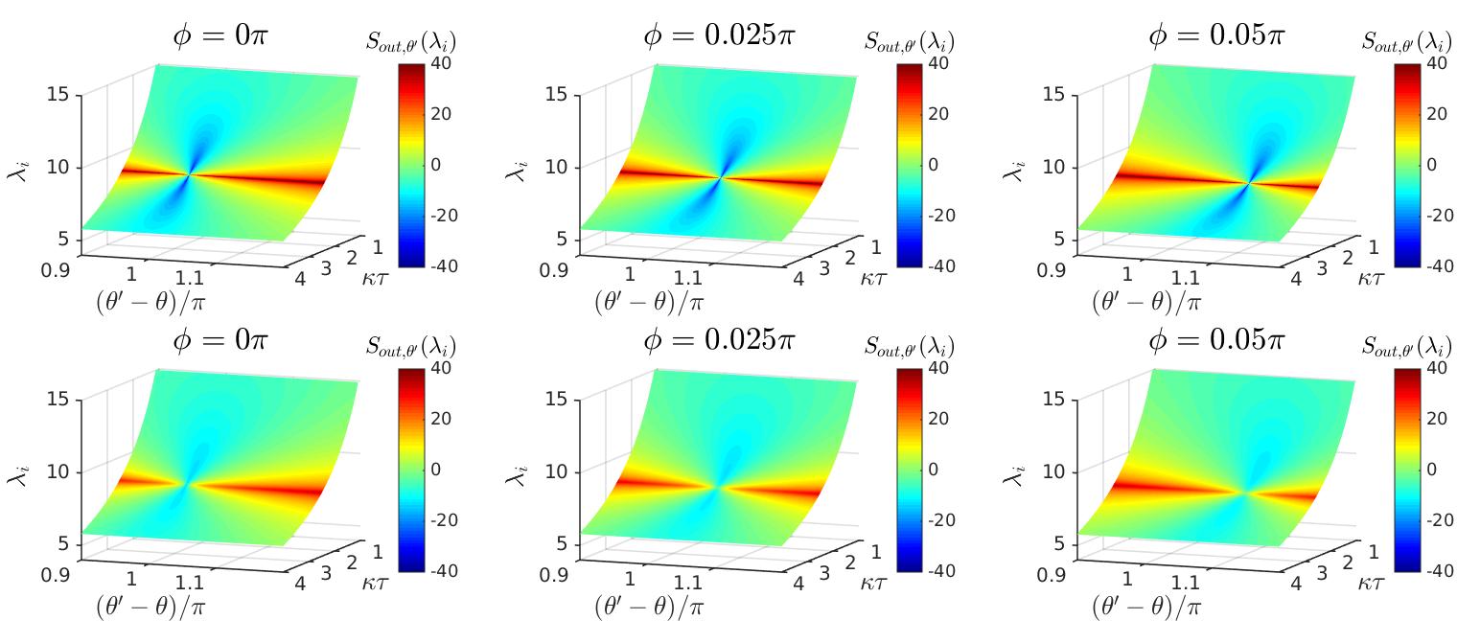
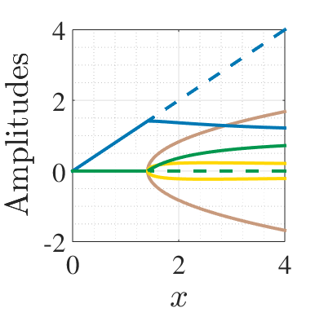
Effects of the phase shift

Slide 22

Gravitational wave detection

Slide 23
More previous studies
Plant and controller system
Controller: two-mode squeezer
C. Bian, G. Zhang, H. W. J. Lee, Int. J. Cont. 85:1865 (2012)
2 OPOs coupled in a feedback loop with a phase difference
H. Mabuchi’s group, Opt. Express 21:1 (2013)
Trapped modes in a linear system
Z. Shi, H. I. Nurdin, arXiv: 1510.08942
Delayed feedback for discreet quantum information: A. Knorr’s group

